Slide 1



Search the
Builder’s New Homes
with the Search KC Builders.com website…

Slide 2
sponsored by
Billy Haas
with Pillar to Post Home Inspectors.

Slide 3
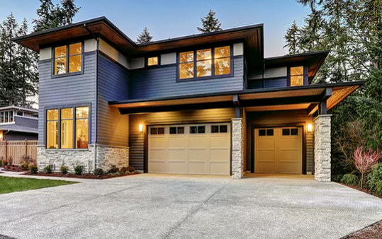
Have you ever considered buying a
New Home from a Builder?

Slide 4
The Search KC Builders.com website
sponsored by Billy Haas
with Pillar to Post Home Inspectors

Slide 5

was specifically designed to help
New Home Buyers
purchase more of the Builder’s New Homes.

Slide 6

It will connect you directly to the Builder’s
Community Maps New Home Floor Plans
Inventory Homes Online Sales Reps

Slide 7

You can use it to:
Perform
New Home Buyer Presentations…

Slide 8
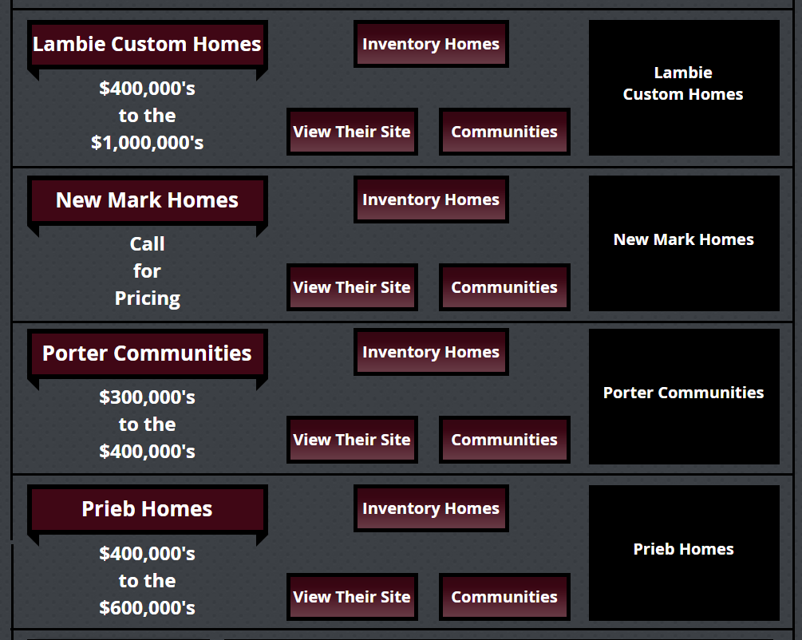
Sort through the
Maze of Builders…

Slide 9
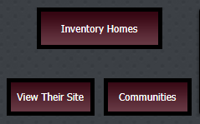
Connect directly to the Builder’s:
New Homes
Websites
Communities

Slide 10

Chat with the Builder’s online Sales Reps to:
Get help finding the right New Home
Get the latest Buyer Incentives
Register your Buyer online!

Slide 11

You can use the
Search KC Builders.com
website...

Slide 12
sponsored by
Billy Haas
with Pillar to Post Home Inspectors...

Slide 13
to find a beautiful New Home from a Builder!

Slide 14
All we ask in return is that you refer us some Business.

Slide 15
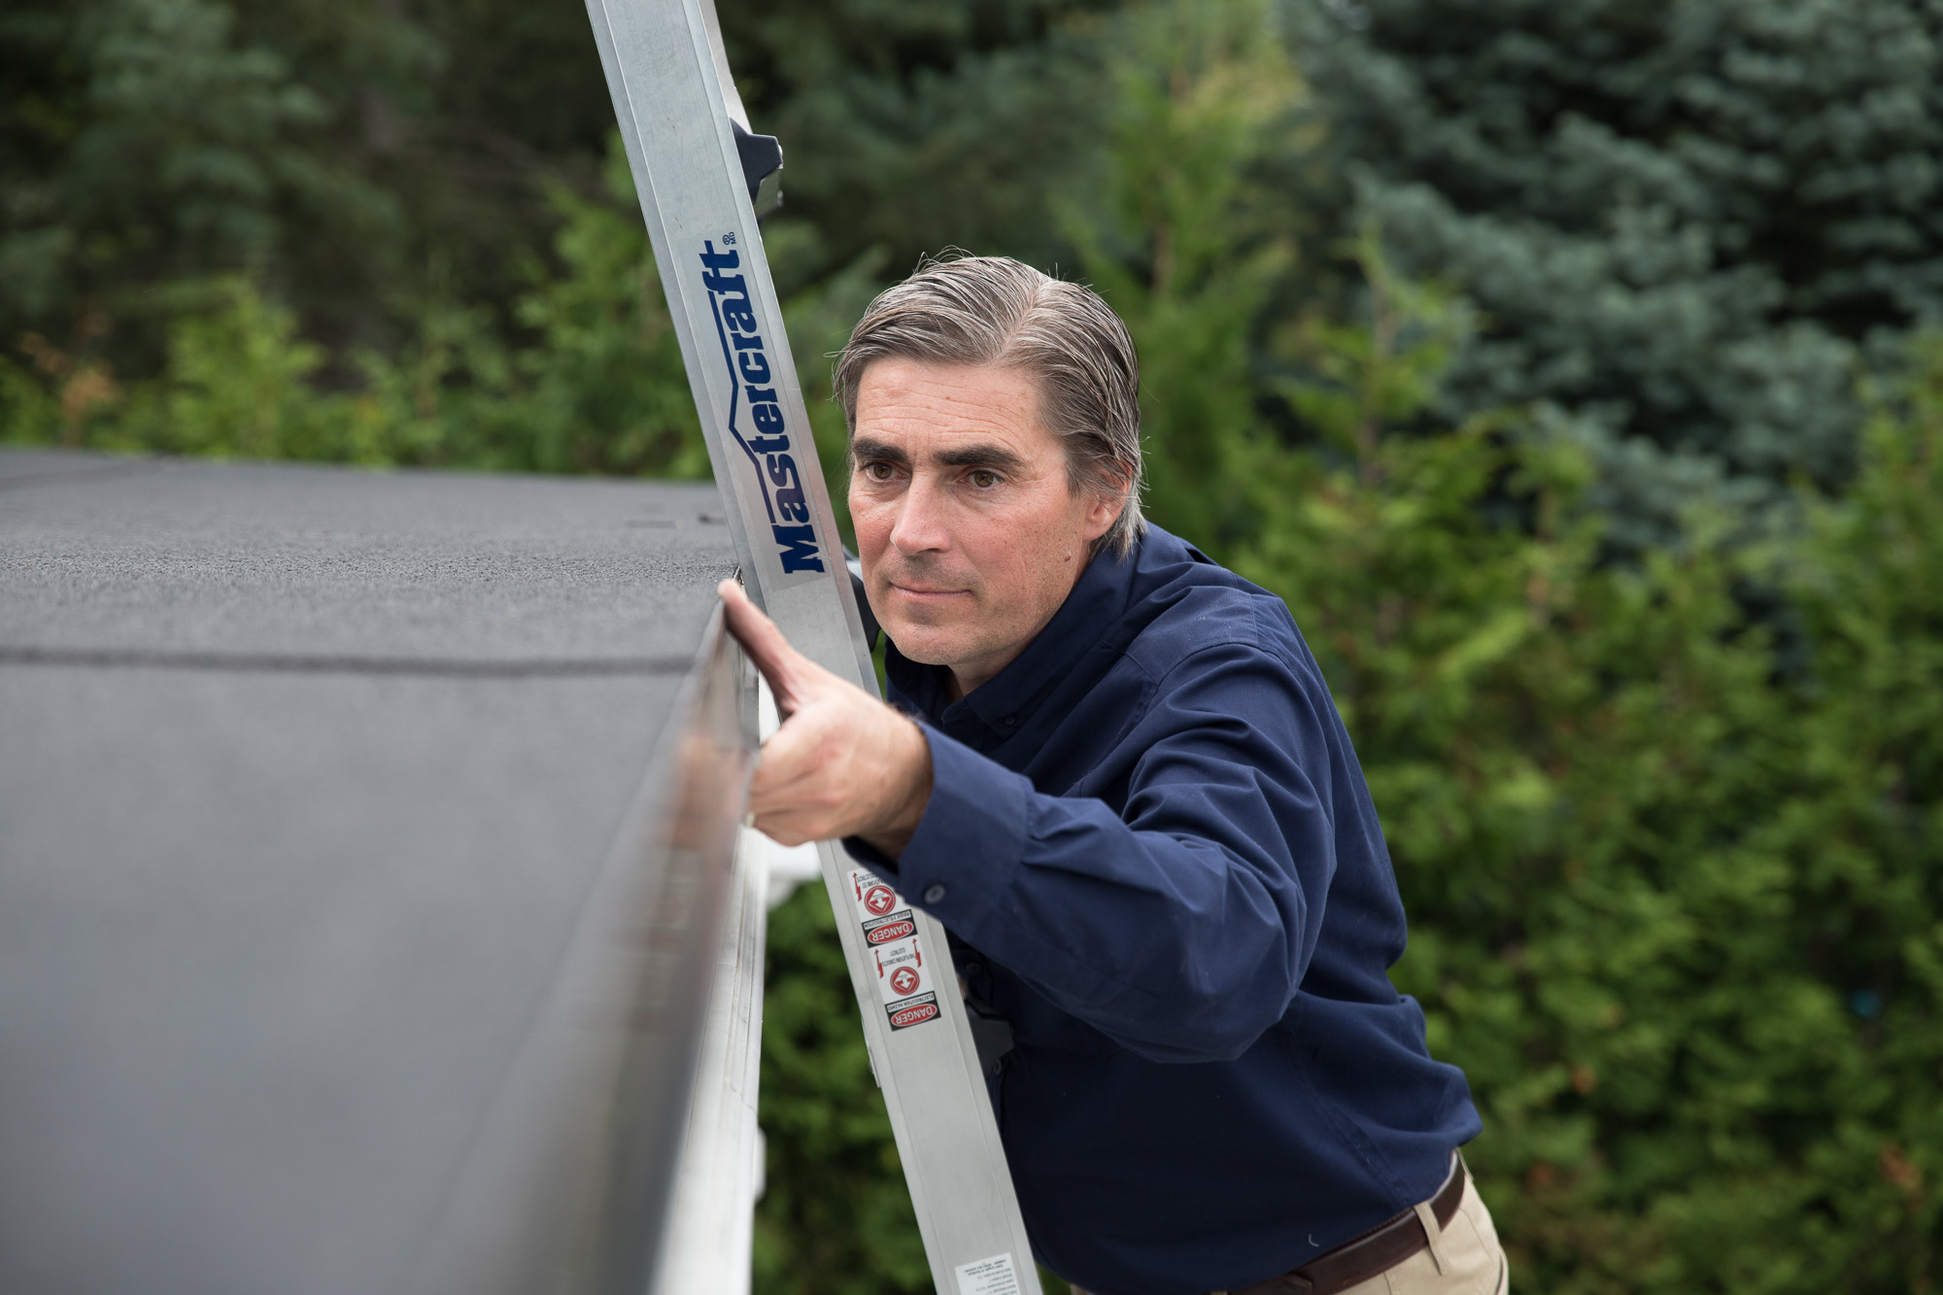
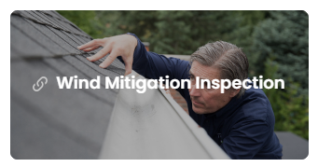

We can provide Home Buyers with
Professional Home Inspections…

Slide 16
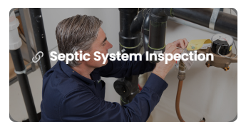
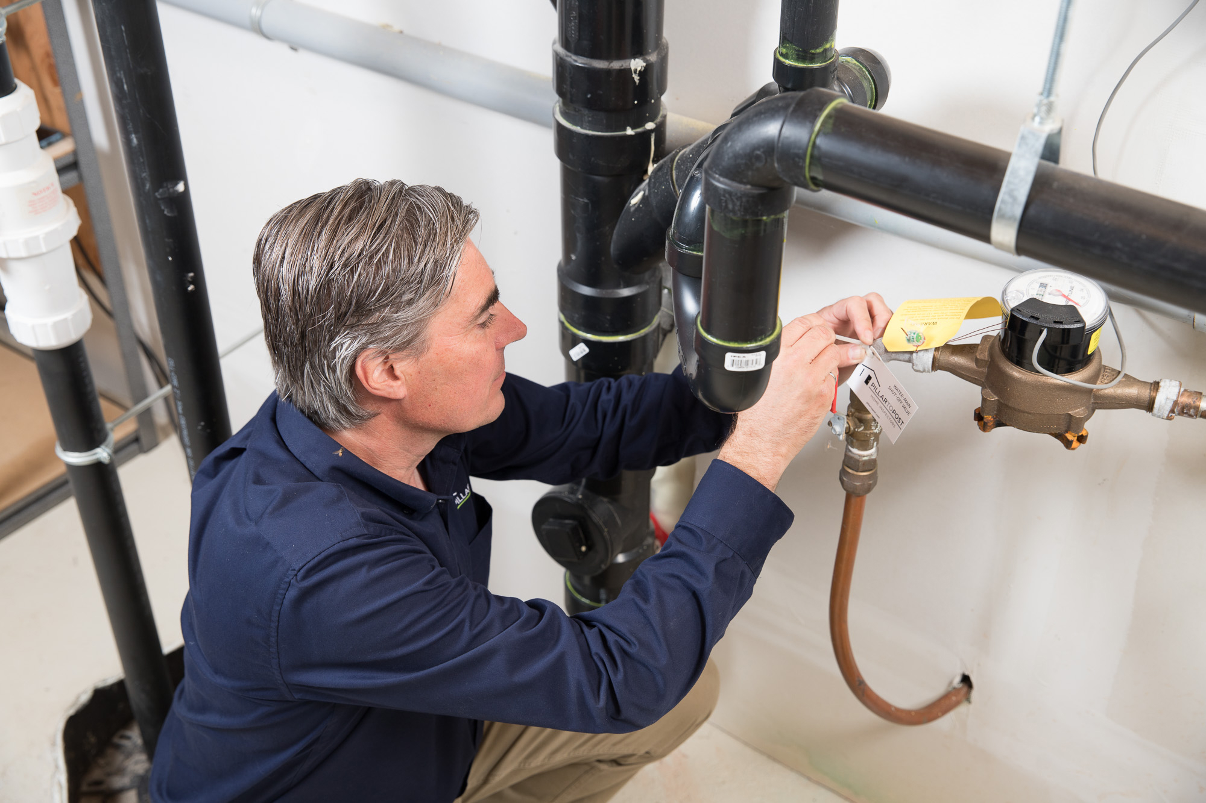
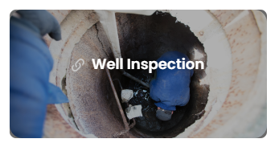
Professional Home Inspections…

Slide 17


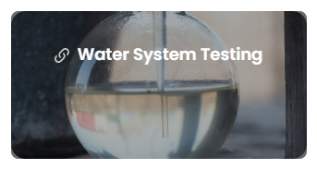
Professional Home Inspections…

Slide 18
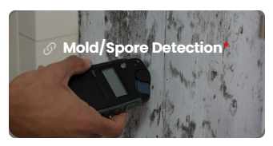

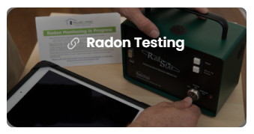
Professional Home Inspections…

Slide 19

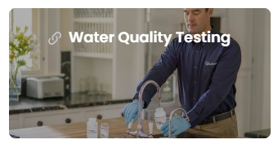
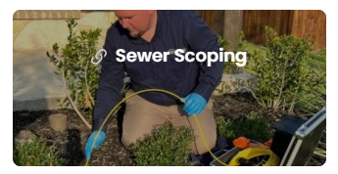
Professional Home Inspections.

Slide 20

Contact Us to Book an Inspection.

